Slide 1
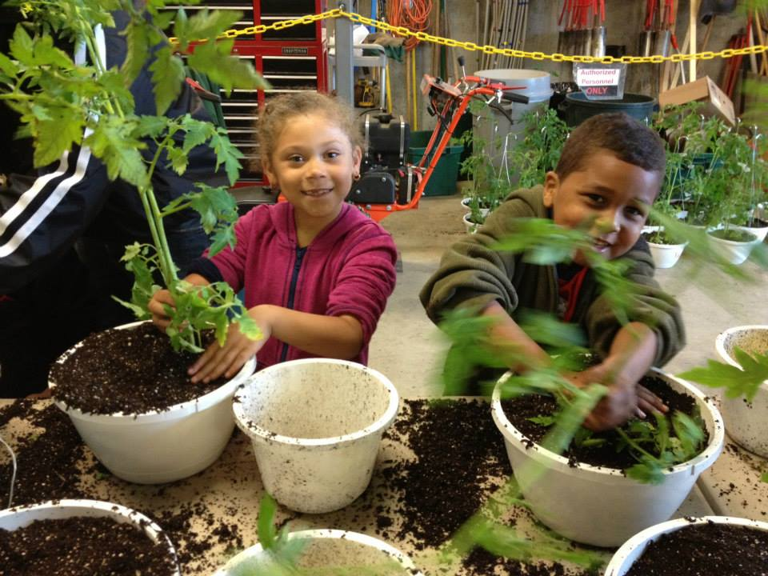
What We Do
Technical Assistance – “Matchmaking”
Promotion
Education & Advocacy
Farm to School Network

Slide 2
Farm to School Network
The Network is designed to help farm to school advocates make the connections and find the resources to build integrated programs that bridge the cafeteria, classroom, and community environments.
  Newsletter & Website
  Learning opportunities & best practices
  Networking activities
  Promotion of member events

Slide 3
Why Serve Local Food?
Serve the freshest, healthy and flavorful foods
Support the local economy
Minimize food waste
Increase student and parent excitement about the lunch program and raise participation
Educate students about where food comes from
Connect to other sustainability initiatives in the school – i.e. school gardens, compost programs etc.

Slide 4

How we can help your school
“Matchmaking” with farms to help you buy local products directly from the farm & work with distributors to source local products.
Free promotional materials to promote
local foods.
Connections to help you expand farm to
school activities from the cafeteria to the
rest of the school environment.

Slide 5
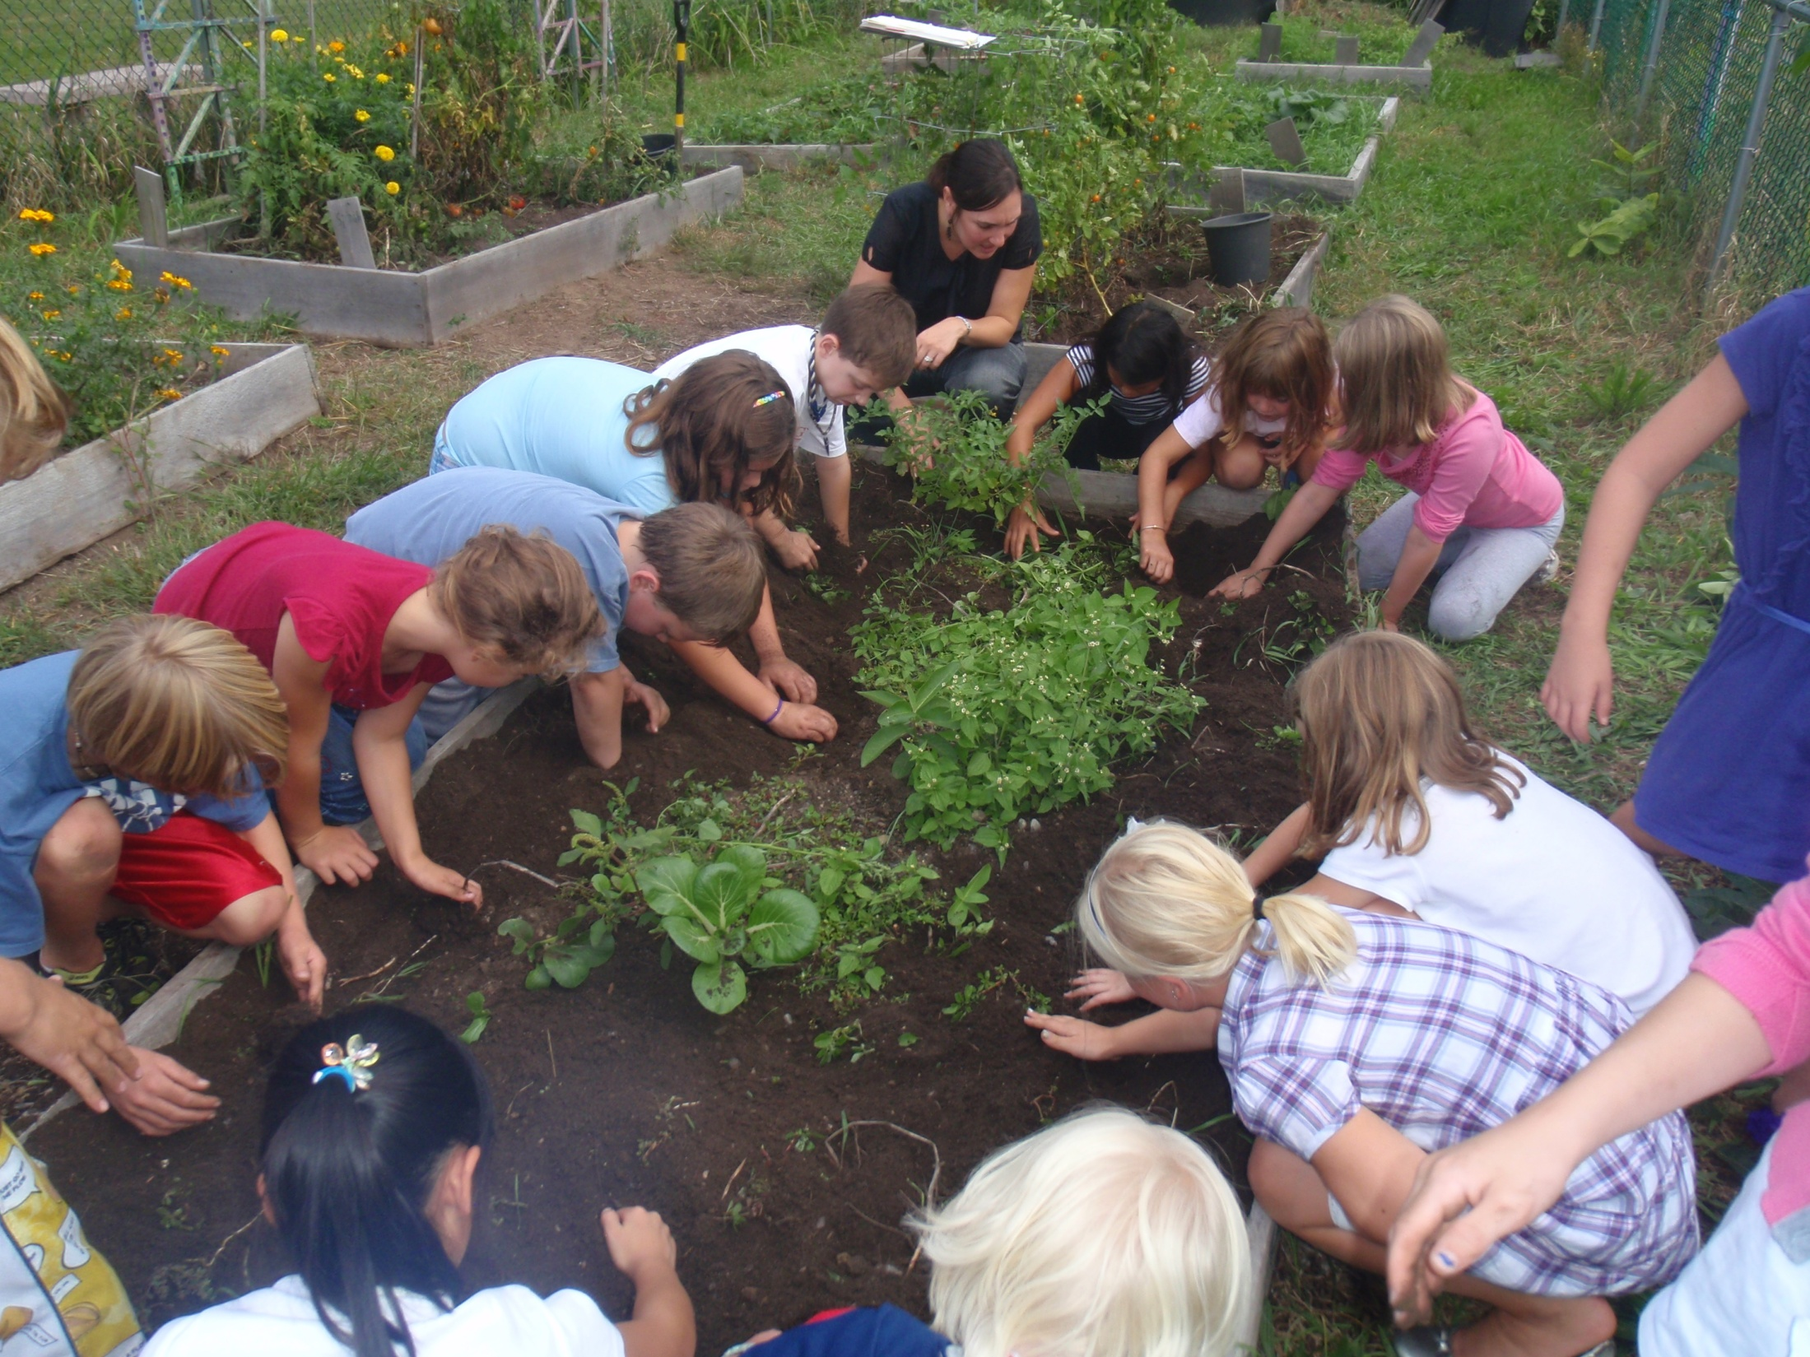
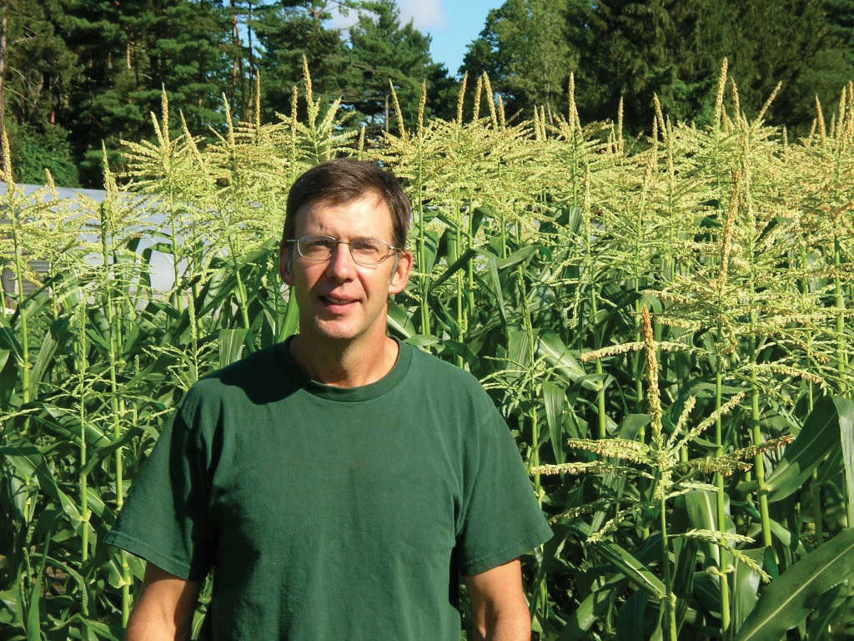
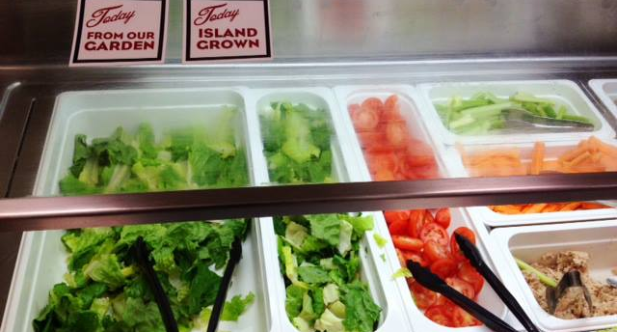
The Three Cs
Community
Classroom
Cafeteria

Slide 6
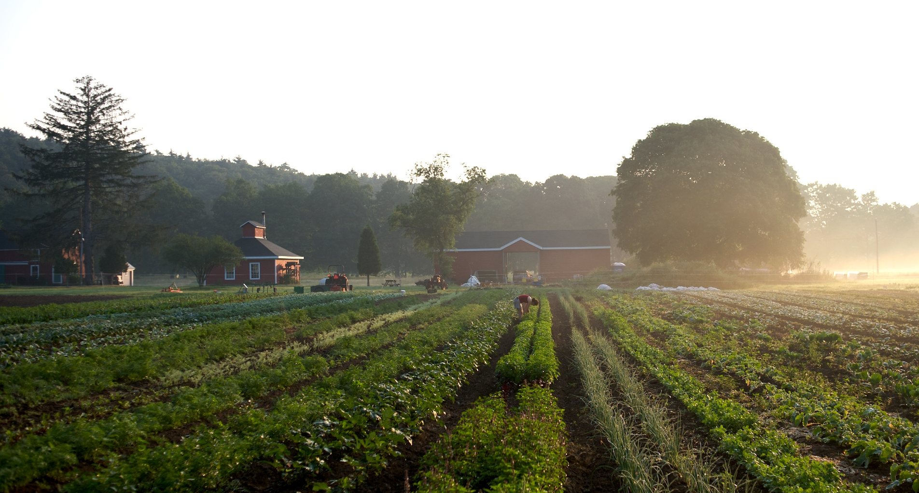
The Cafeteria & Community Connection:
Building a Successful Farm to School Relationship
There are many ways to bring local foods to the cafeteria. Which way (of multiple ways) is right for your institution?
Direct from the farm
Through a local foods distributor
Through a convention produce distributor
Through a broad line distributor

Slide 7
Local Sourcing Opportunities

Slide 8
The Cafeteria & Classroom Connection:
Harvest of the Month
  Promote a different Mass. grown crop each month
  Increase healthy food choices through exposure to seasonally grown fruits/vegetables
  Receive free promotional materials – posters, trading cards, stickers and more!
  Curricular connections & home activities
  Individual assistance from Mass. Farm to School staff

Slide 10
Mass. Farm to School is here to support your efforts
Contact us for more info:
Eastern Mass.
Simca Horwitz
617-239-2574
simca@massfarmtoschool.org
Central & Western Mass.
Lisa Damon
413-253-3844
lisa@massfarmtoschool.org

